Slide 1
ANXIETY’S
ROLE IN AMPLIFYING CONCERNS
Stephanie L. DeMora, University of Pennsylvania

Slide 2
RESEARCH QUESTIONS
Does anxiety increase concerns, or does it work the other way around?
Do norms and information mediate this relation?
Do these pathways work the same for everyone?
Does this matter for other outcomes?

Slide 3
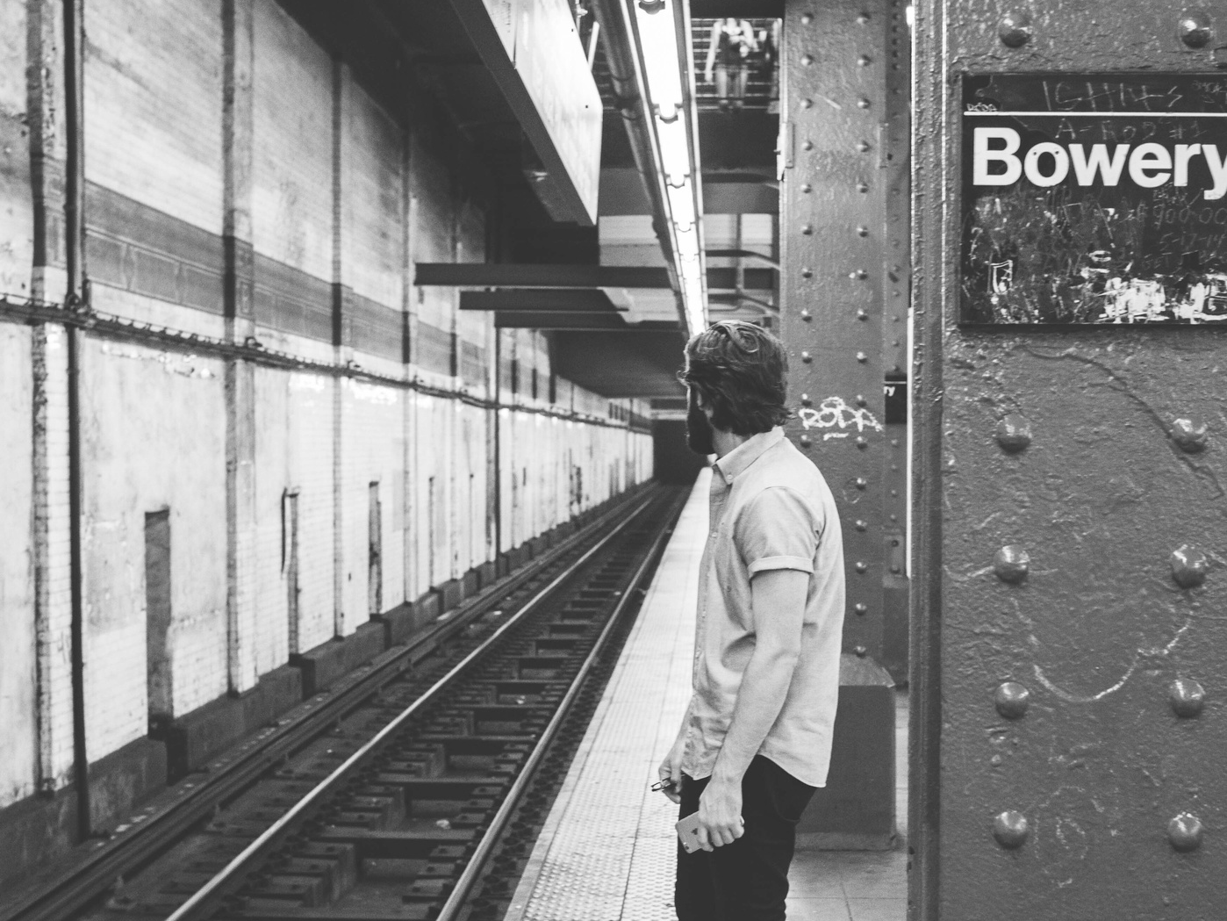
THEORY
Option 1: Specific concerns increase general anxiety
Option 2: Anxiety may increase specific concerns across the board.
Option 3: Anxiety may polarize partisans.

Slide 5
Data Source
Longitudinal survey of 2,020 Americans
6 waves
July 2022 – September 2023

Slide 6
Measures: General Anxiety
STATE AND TRAIT ANXIETY (STATE) MEASURES
I AM TENSE
I AM WORRIED
I FEEL CALM (REVERSE CODED)
I FEEL SECURE (REVERSE CODED)
MUSIC
ART

Slide 7
Measures: Specific Concerns
IN THE NEXT 3 MONTHS, HOW CONCERNED, IF AT ALL, ARE YOU ABOUT...
JUST YOUR BEST GUESS, IN THE NEXT 3 MONTHS, HOW SEVERE (LIFE-THREATENING AND CAUSING DISRUPTIONS), IF AT ALL, ARE...
…new pathogens (e.g., COVID-19) producing outbreaks and pandemics in the US?
…storms, hurricanes, and wildfires happening?
…the potential for violence in the US?
MUSIC

Slide 8
 | Influence | Reverse
New Pathogens | 0.074, p < 0.001 | 0.004, p = 0.601
Natural Disasters | 0.113, p < 0.001 | 0.012, p = 0.142
Potential for Violence | 0.068, p < 0.001 | 0.015, p = 0.074

Slide 9
Measures: Mediated Paths
BASED ON WHAT YOU HAVE SEEN IN THE PAST 3 MONTHS, HOW CONCERNED, IF AT ALL, ARE YOUR FRIENDS AND FAMILY MEMBERS ABOUT…
IN THE PAST 3 MONTHS, HOW FREQUENTLY, IF AT ALL, HAVE YOU ENCOUNTERED INFORMATION ABOUT ... IN THE MEDIA (E.H. CABLE NEWS AND SOCIAL MEDIA)?

Slide 10
 | Norms | Information
New Pathogens | 0.040, p < 0.001 | 0.005, p = 0.001
Natural Disasters | 0.049, p < 0.001 | 0.002, p = 0.006
Potential for Violence | 0.029, p < 0.001 | 0.013, p < 0.001

Slide 11
Mediation Pathways
Informational Influences
Specific Concerns
Specific Behaviors or Behavioral Intentions
Anxiety
Normative Influences

Slide 12
Behavioral Outcomes
PATHOGENS AND PANDEMICS
COVID-19 VACCINATION
INFLUENZA VACCINATION
MASK WEARING
NATURAL DISASTERS
STORING FOOD AND WATER
VIOLENCE
SUPPORT FOR POLITICIANS

Slide 13
Mediation Pathways:
Democrats
Informational Influences
Specific Concerns
Specific Behaviors or Behavioral Intentions
Anxiety
Normative Influences

Slide 14
Mediation Pathways:
Republicans & Independents
Informational Influences
Specific Concerns
Specific Behaviors or Behavioral Intentions
Anxiety
Normative Influences

Slide 15
Thank you!

